Slide 1
INFORMATION SYSTEMS SECURITY, CONTROL AND AUDIT
Information Systems Security
Week 2

Slide 2
Defining Information Systems Security
An information system consists of the hardware, software, operating system, and application software that work together to collect processes, and store data for individuals and organisations.

Slide 3
Defining Information Systems Security
Information systems security is the collection of activities that protect the information system and the data stored in it.

Slide 4
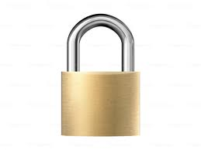

Defining Information Systems Security
Application Systems
Intellectual
Property
Hardware
Software
Operating System

Slide 5
Definition of Risks, Threats and Vulnerabilities.
Risk is the likelihood that something bad will happen to an asset.
A threat is any action that could damage an asset.
A vulnerability is a weakness that allows a threat to be realized or to have an effect.

Slide 6
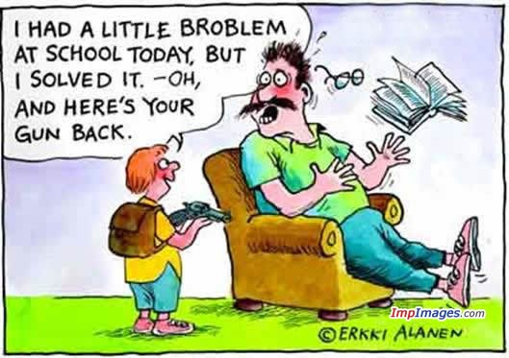
Tenents of Information Systems Security (Availability, Integrity, Confidentiality)
Availability – Information is accessible by authorized users whenever they request the information.
Notes:
Uptime, Downtime, Availability, Mean time to failure, Mean time to repair, Recovery time objective

Slide 7
Tenents of Information Systems Security (Availability, Integrity, Confidentiality)
Measuring Availability
Availability = (Total Uptime)/(Total Uptime + Total Downtime)
To calculate uptime for a 31 day month
31 days x 24 hours/day x 60 minutes/hour = 44, 640 minutes
Notes:
Uptime, Downtime, Availability, Mean time to failure, Mean time to repair, Recovery time objective

Slide 8
Tenents of Information Systems Security (Availability, Integrity, Confidentiality)
Measuring Availability
Availability = (Total Uptime)/
(Total Uptime + Total Downtime)
Assuming your server suffers a downtime of 20 hours in January, 2015. Calculate the Availability factor.
Notes:
Uptime, Downtime, Availability, Mean time to failure, Mean time to repair, Recovery time objective

Slide 9
Tenents of Information Systems Security (Availability, Integrity, Confidentiality)
January 2015 = 31 days
Uptime is
31 days x 24 hours/day x 60 minutes/hour =
44, 640 minutes
Server Availability in January 2015 =
(44,640 mins)/(44,640 mins + 1,200 minutes)
= 0.9738 or 97.3%
Notes:
Uptime, Downtime, Availability, Mean time to failure, Mean time to repair, Recovery time objective

Slide 10
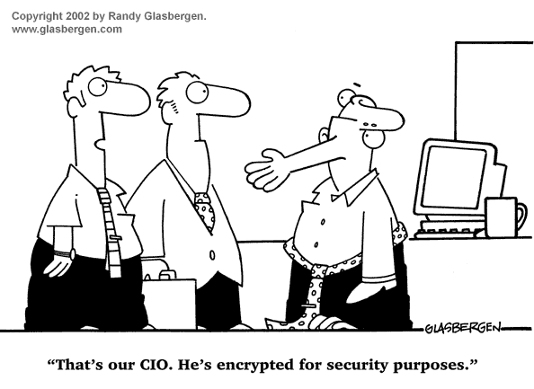
Tenents of Information Systems Security (Availability, Integrity, Confidentiality)
Integrity – Only authorized users can change information.

Slide 11
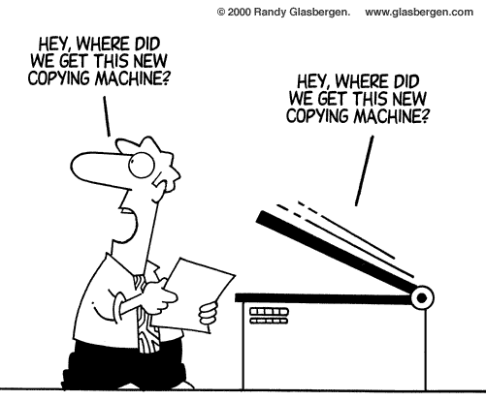
Tenents of Information Systems Security (Availability, Integrity, Confidentiality)
Confidentiality – Only authorized users can
view information.

Slide 12
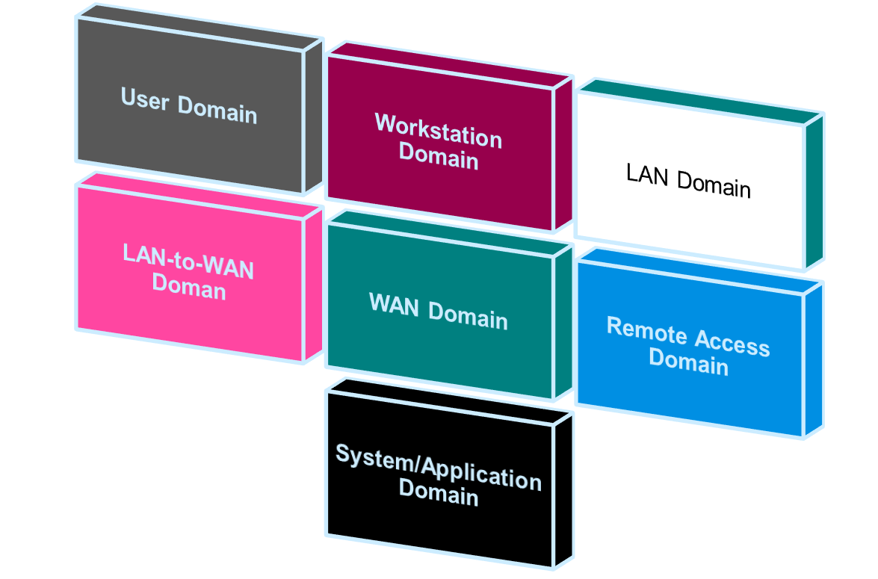
Seven Domains of a Typical IT Infrastructure
Notes:
Seven Domains of a Typical IT Infrastructure

Slide 13
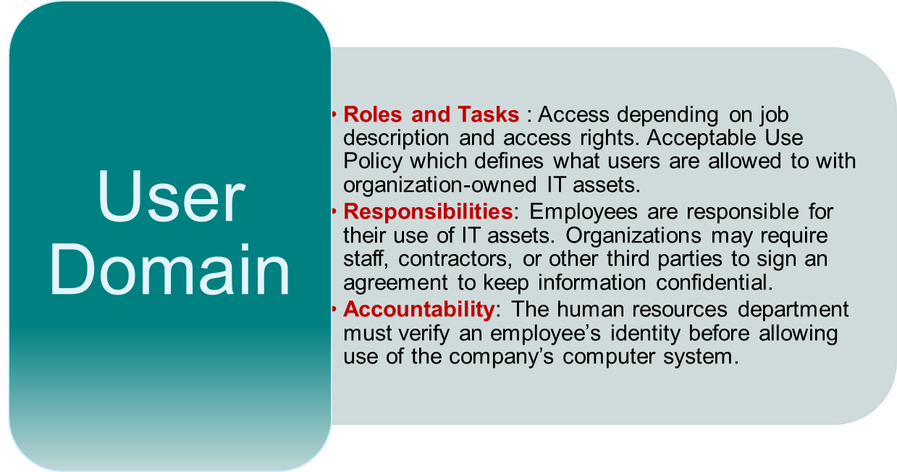
Seven Domains of a Typical IT Infrastructure
Notes:
Risks – Lack of user awareness, user apathy towards policies, security policy violations, user downloads, disgruntled employee attacks.

Slide 14
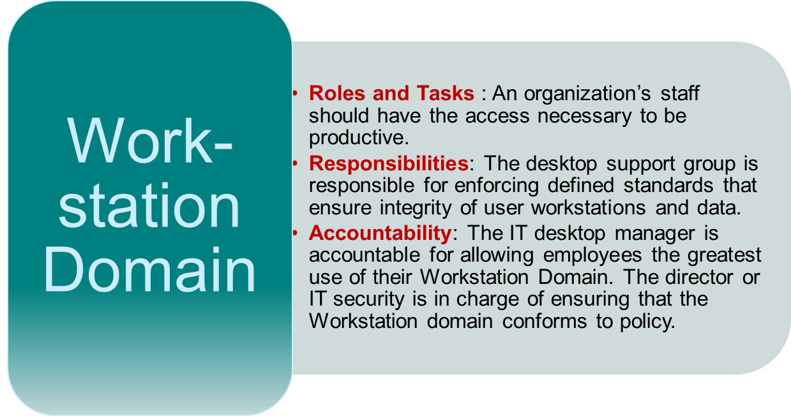
Seven Domains of a Typical IT Infrastructure
Notes:
Risks – unauthorized access to workstations, software vulnerabilities, viruses/malicious code infection, user downloads.

Slide 15
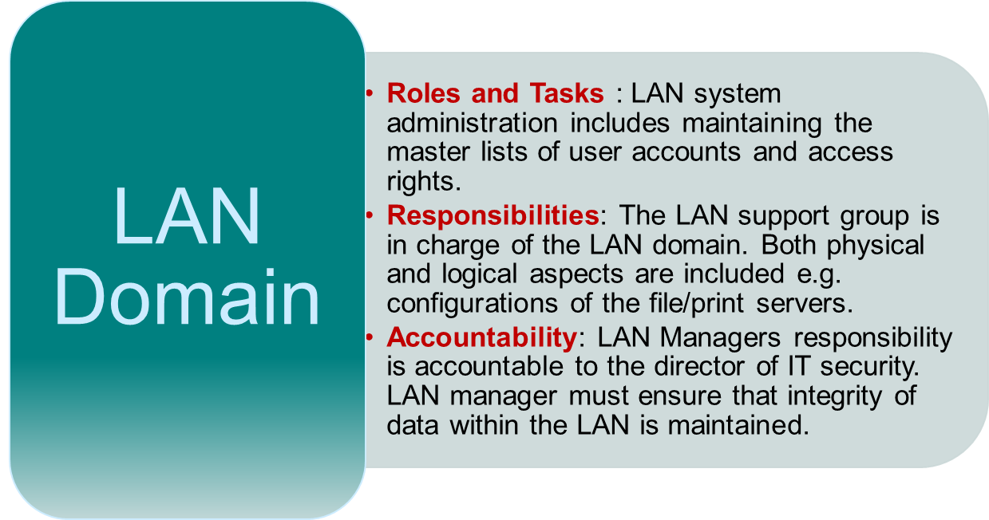
Seven Domains of a Typical IT Infrastructure
Notes:
Risks – unauthorized access to LAN, unauthorized access to systems, applications, and data, LAN server operating system vulnerabilities.

Slide 16
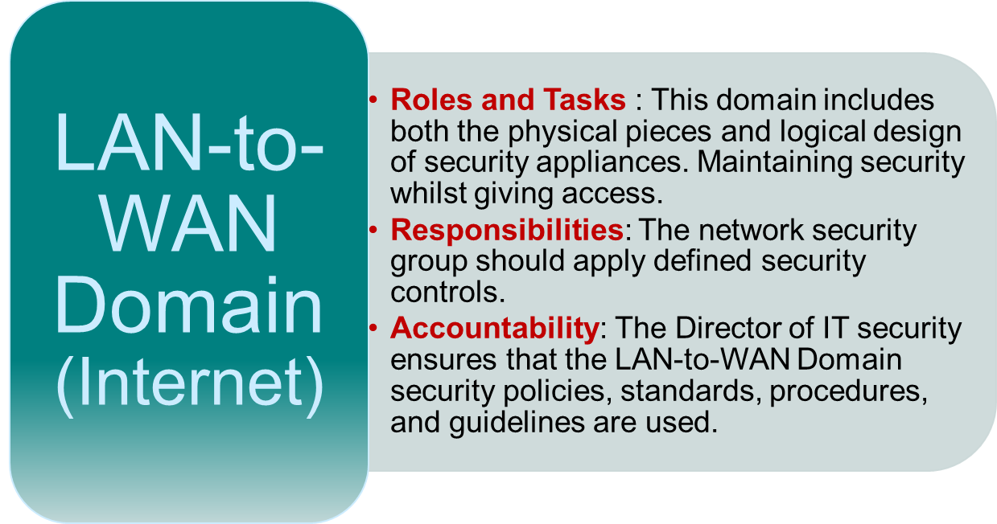
Seven Domains of a Typical IT Infrastructure
Notes:
IP Routers, IP Firwalls, DMZ, IDS, IPS, Proxy Servers, Web Content Filter
Risks – Unauthorized network probing, Unauthorized access through the LAN-to-WAN Domain, IP Router, firewall and network appliance operating system software vulnerability etc

Slide 17
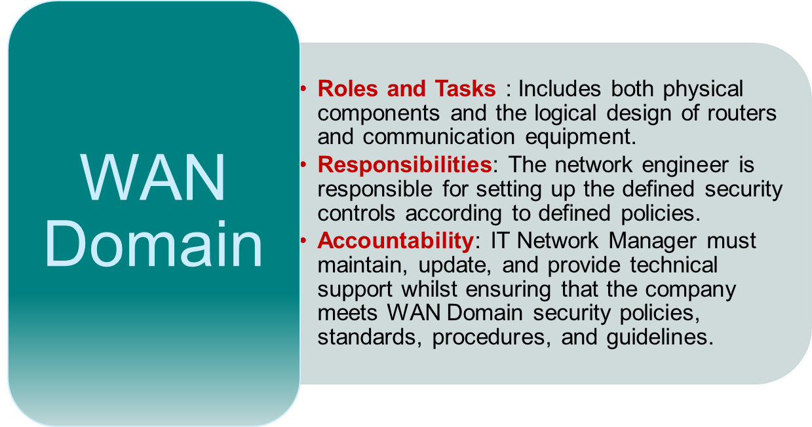
Seven Domains of a Typical IT Infrastructure
Notes:
Nationwide Optical backbones, End to End IP transport, Multi-site WAN cloud services
Risks – Open, public, easily accessible, eavesdropping, corruption of data, TCP applications that are inherently insecure

Slide 18
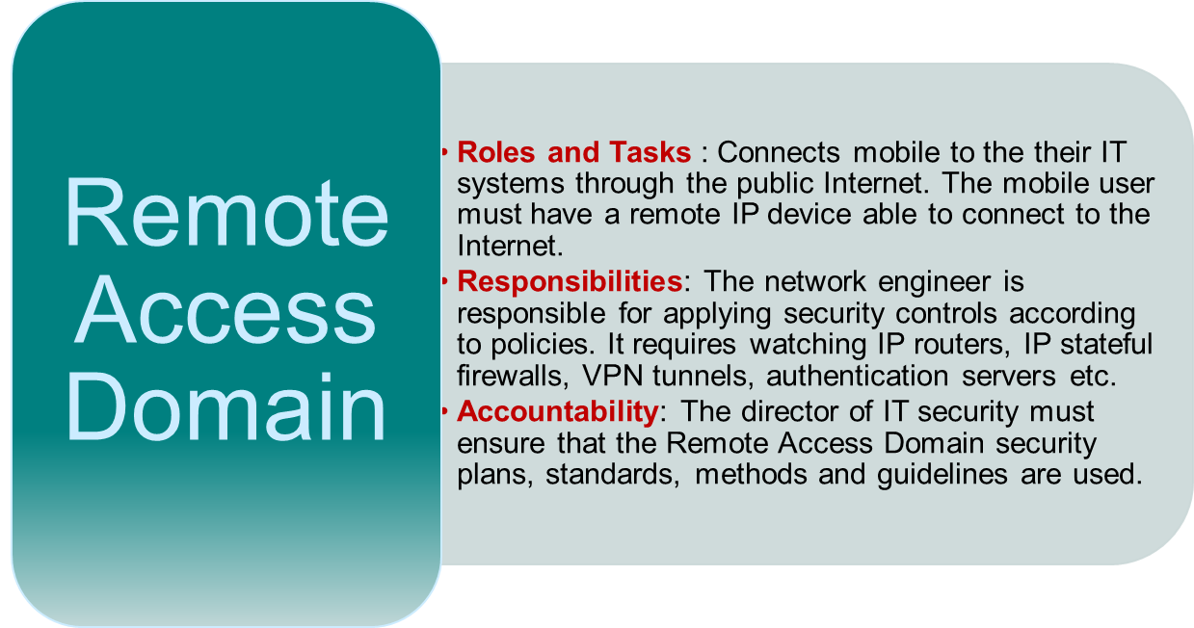
Seven Domains of a Typical IT Infrastructure
Notes:
Cell phones, smartphones, PDAs, Laptop VPN client software, secure browser software, SSL, authentication software
Risks – Brute force user password attacks, unauthorised remote access to IT systems, theft of laptop/token etc

Slide 19
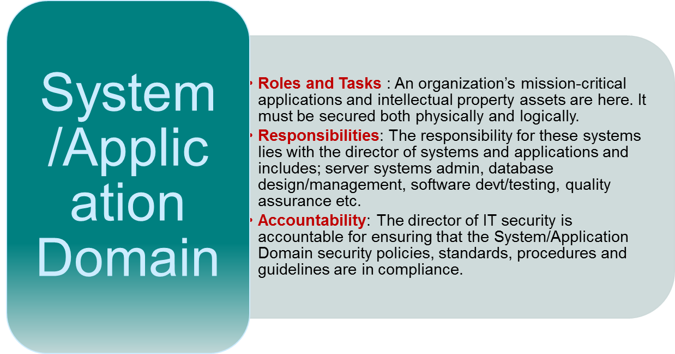
Seven Domains of a Typical IT Infrastructure
Notes:
Critical corporate systems eg human resources and payroll, accounting and financial, customer-relationship management (CRM), Sales Order Entry
Cell phones, smartphones, PDAs, Laptop VPN client software, secure browser software, SSL, authentication software
Risks – Brute force user password attacks, unauthorised remote access to IT systems, theft of laptop/token etc

Slide 20
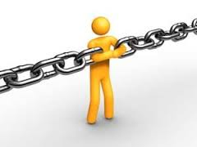
The Weakest Link in any ICT Infrastructure
Chain of policy, practice and architecture

Slide 21
IT Security Policy Framework
Acceptable Use Policy (AUP) – defines what actions are and are not allowed with respect to the use of organization owned IT assets.
Security Awareness Policy – defines how to ensure all personnel are aware of the importance of security and behavioural expectations under the organisations security policy.
Asset Classification Policy – defines an organization’s data classification standard. It tells what IT assets are critical to the organisations mission.

Slide 22
IT Security Policy Framework
Asset Protection Policy – defines a priority for mission-critical IT systems and data. This policy is aligned with an organization’s business impact analysis (BIA) and is used to address risks that could threaten the organization’s ability to continue operations after a disasters.
Asset Management Policy – Includes the security operations and management of all IT assets with the seven domains of a typical IT infrastructure.
Vulnerability Assessment & Management – This policy
defines an organization wide vulnerability window for production operating system and application software.

Slide 23
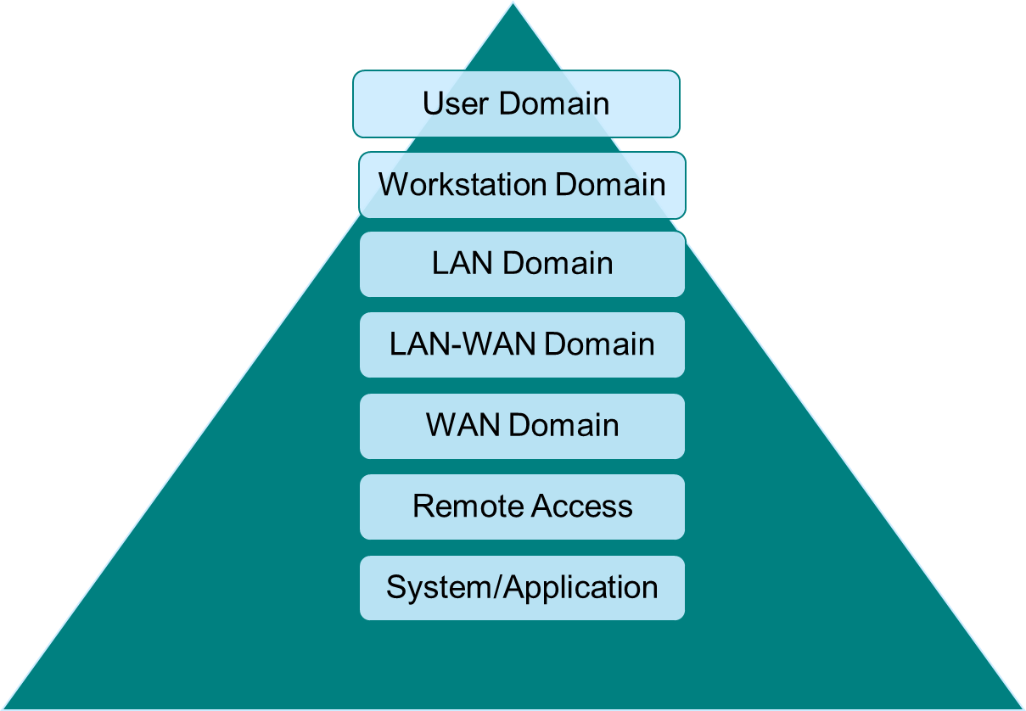
Domains/Security Policy
Security Policies

Slide 24
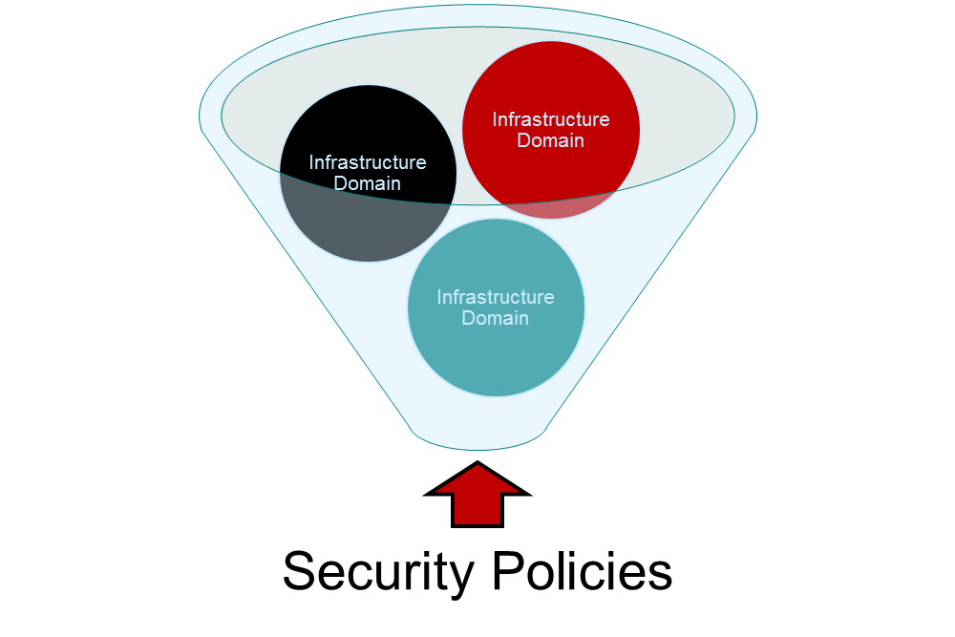
Domains/Security Policy

Slide 25
Distinct between Policies, Standards, Procedures and Guidelines

Slide 26
End

